Slide 1
Interest Free Agriculture E-Credit Scheme BY Dr. Amjad Saqib 08-11-2016

Slide 2
Background of Project
The Government of Punjab (GoPb) has taken an initiative to promote the wellbeing of small farmers, having land holding up to 2.5 Acres, through provision of interest free loans. The objective of the Interest Free Agriculture E-Credit Scheme is to increase the outreach of formal and digital financial services to ensure financial inclusion.

Slide 3
Salient Features
Available in all districts of Punjab.
Farmers having land holding of up to 2.5 acres.
Tenants and sharecroppers are also eligible for Interest Free Loans.
The applicant farmer/Tenant/share cropper should be the resident of same village where the land is located.
30% farmers may have existing lending relations with financial institutions whereas 70 % would be fresh borrowers.
Service charges of SPO shall be borne by Government of Punjab.
Loans will be awarded on social or personal guarantees.

Slide 4
Loan Process
for
Agri E-Credit Scheme

Slide 5
1. Program Introduction
3. Application submission by potential borrowers
9. Loan Approved by Loan Approval Committee
14.Regular visits of field
6.Agriculture Appraisal by staff
5.Social Appraisal by staff
7.Guarantors of Loans
(to be provided by farmers)
15.Recoevry of Loan
2. LRMS Verification/
Registration
4.Selection of farmers on PITB portal
10.Final Approval from Agri. Dept.
11.Asaan Account
13. Social guidance & paper Disbursement
12.Smart phones and mobile wallets
8.Finalization of documents
Loan Process for
Agri. E-Credit Scheme

Slide 6
Funds Flow
for
Agri E-Credit Scheme

Slide 7
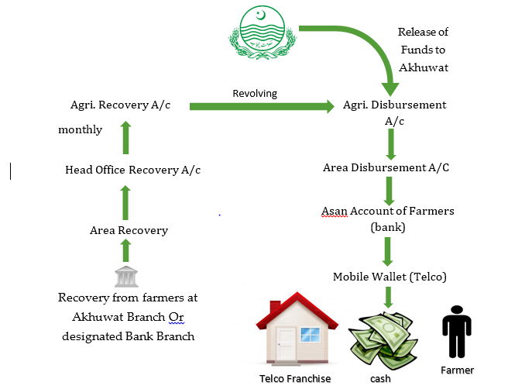

Slide 8
Public Private Partnership

Slide 9
Public Private Partnerships
Sr. NO | Scheme Name | Start Date | Funds Allocated $ | Funds Received $
1 | Chief Minister’s Self Employment Scheme (CMSES-Punjab) | October 2011 | 100 Million | 85.00 Billion
2 | Chief Minister’s Self Employment Scheme- Gilgit Baltistan (CMSES-GB) | April 2013 | 3.85 Million | 3.85 Million
3 | Prime Minister’s Interest Free Loan Scheme (PMIFL) | August 2014 | 4.46 Million | 4.46 Million
4 | Governor KP Scheme for Federally Administrative Tribal Areas (FATA) | September 2015 | 5.00 Million | 4.12 Million
5 | Technical Educational and Vocational Training Authority (TEVTA) Interest Free Loan Scheme | October 2015 | 5.00 Million | 5.00 Million

Slide 10
Salient Features
First ever interest free loans projects on such scale.
Loan size ranges from Rs. 10,000 to Rs. 50,000.
Loans are given for businesses and setting small enterprise only.
Graduates of PVTC, TEVTA and technical/vocational institutions are preferred.
Loans are disbursed in mosques/church to ensure transparency and participation.
There is no mark-up or interest on these loans.
Loans are disbursed in 450 locations of 60 districts of the province.

Slide 11
Salient Features
Loans are given after due scrutiny and appraisal according to an eligibility criterion, on first come first serve basis.
More than 1,400,000 loans have been disbursed so far.
This is the largest interest free small loans scheme in Pakistan jointly ventured by a Government agency and a civil society organization.
Total funds released so far: Rs. 10 billion

Slide 12
Progress Report of CMSES- Punjab

Slide 13
Akhuwat Branches

Slide 14
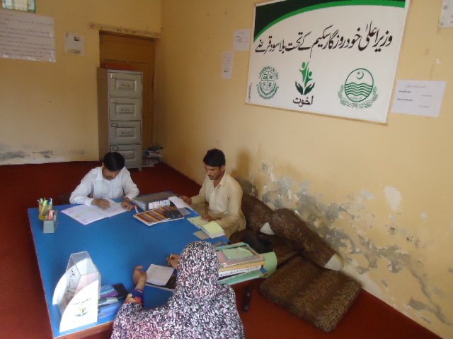
Picture of Rajanpur Branch, Rajanpur

Slide 15
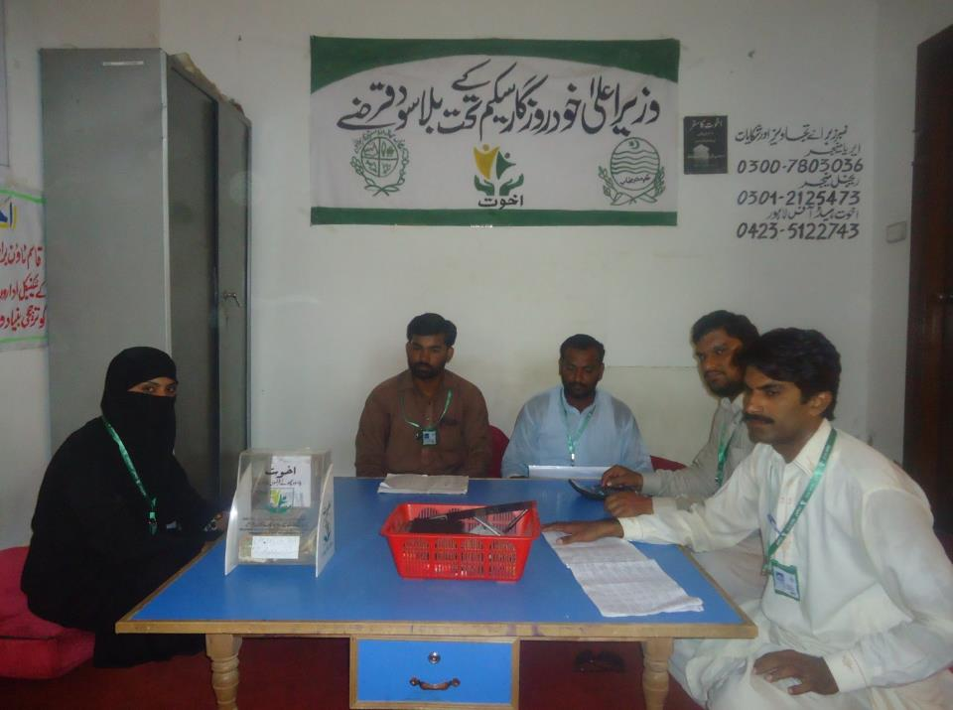
Picture of Bahwalpur Qasim Town Branch, Bahawalpur

Slide 16
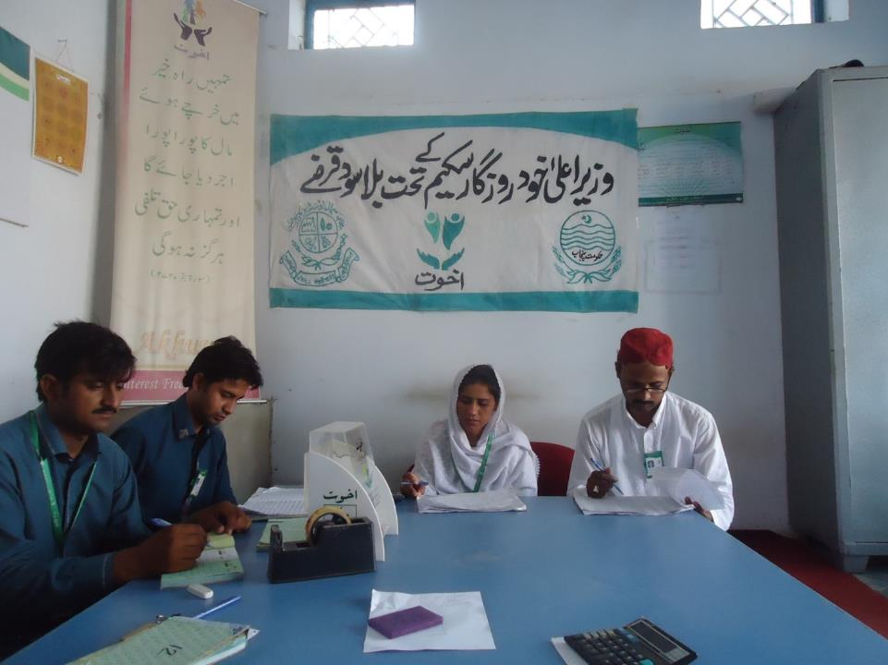
Picture of Jahania Branch, Khanewal

Slide 17
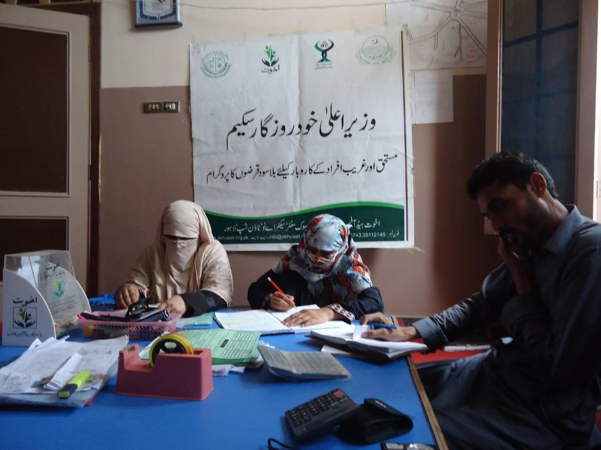
Picture of D.G Khan Branch

Slide 18
Beneficiaries of Akhuwat

Slide 19
Bicycle Repair

Slide 20
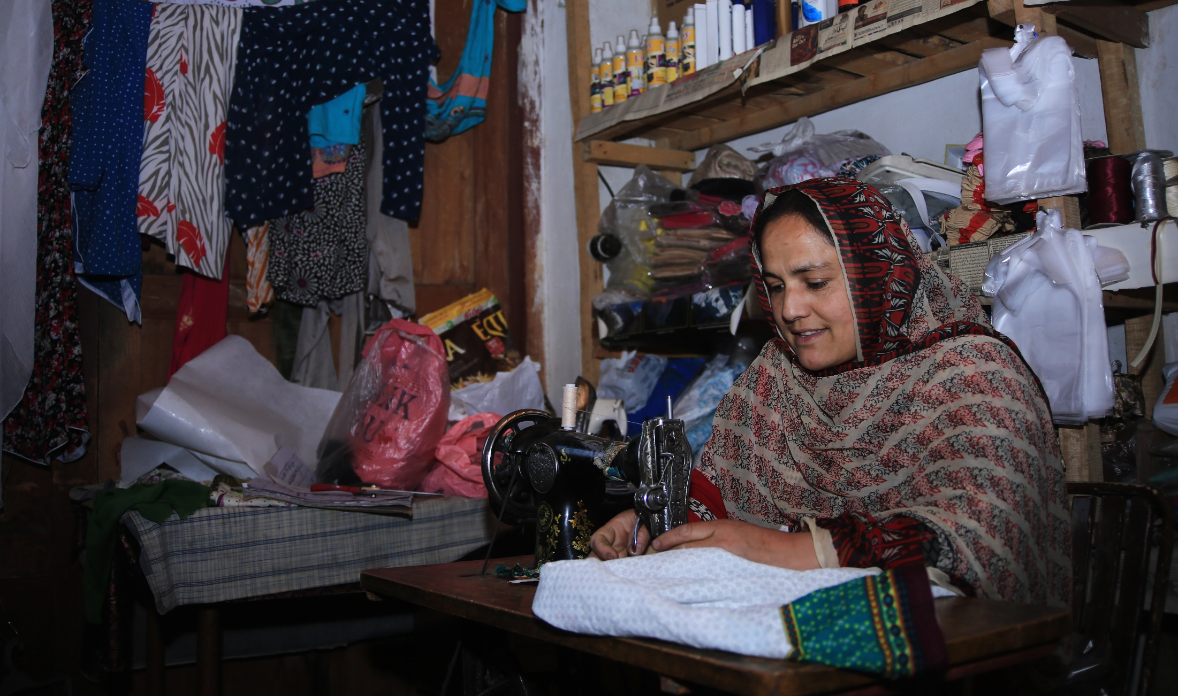
Sewing & Tailoring

Slide 21
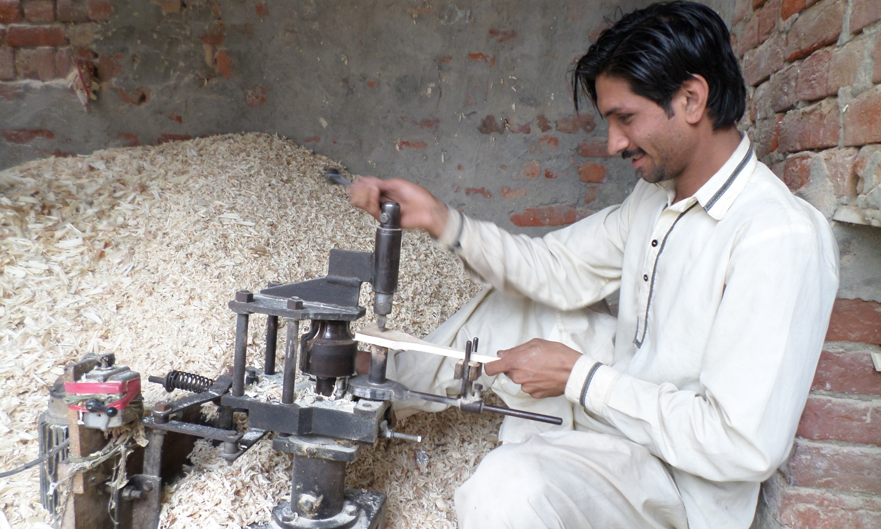
Carpenter

Slide 22
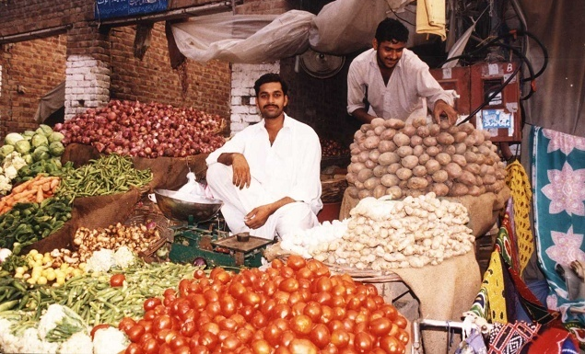
Vegetable Stall

Slide 23
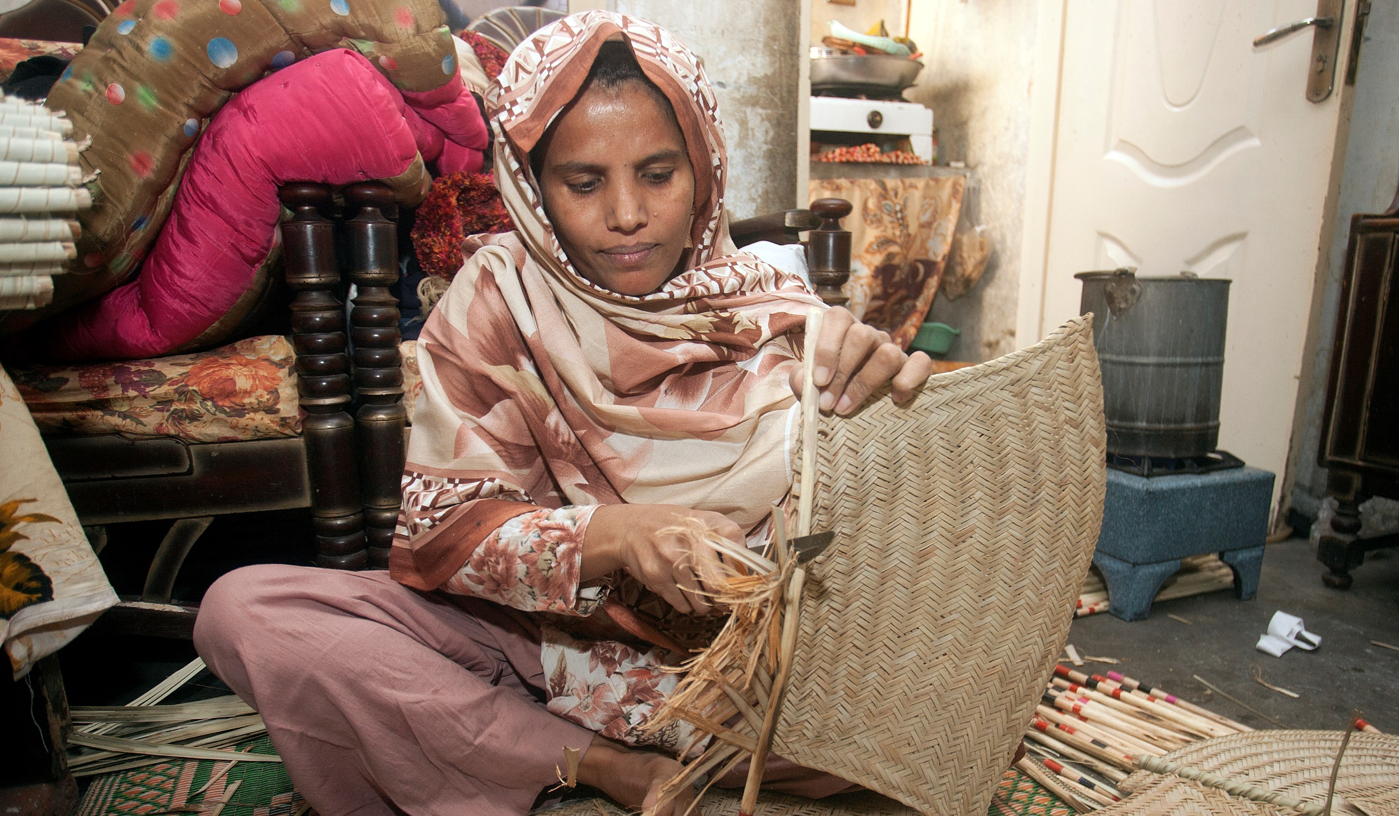
Production

Slide 24
Thank You

